Slide 1
R Week 4
Jon Clucas and Bonhwang Koo

Slide 2
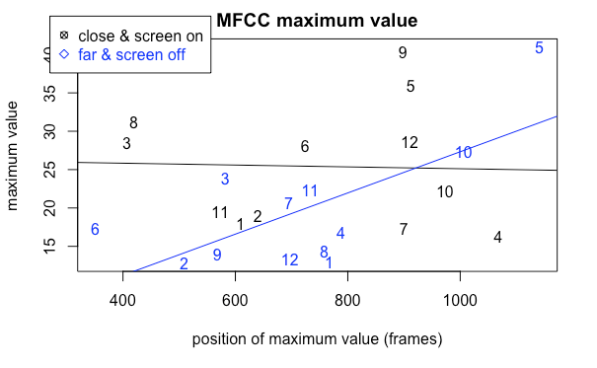
Answers to previous questions
How to put a legend outside a plot: par(xpd = TRUE)
Quadratic model: lm(y ~ poly(x, 2))
Another way to plot multiple datasets in a single plot: par(new = TRUE)

Slide 3
ANOVA
One-way ANOVA
fit <- aov(y ~ x, data=dataframe)
Repeated measures ANOVA
fit <- aov(y~x+Error(Subject/x),data=dataframe)

Slide 4
Install.packages & library
install.packages(“swirl”) - Download package & install
library(“swirl”)- Load package to environment

Slide 5
ggplot2
“ggplot2 is based on the grammar of graphics, the idea that you can build every graph from the same few components: a data set, a set of geoms-- visual marks that represent data points, and a coordinate system.”
ggplot2 cheat sheet: https://www.rstudio.com/wp-content/uploads/2015/03/ggplot2-cheatsheet.pdf

Slide 6
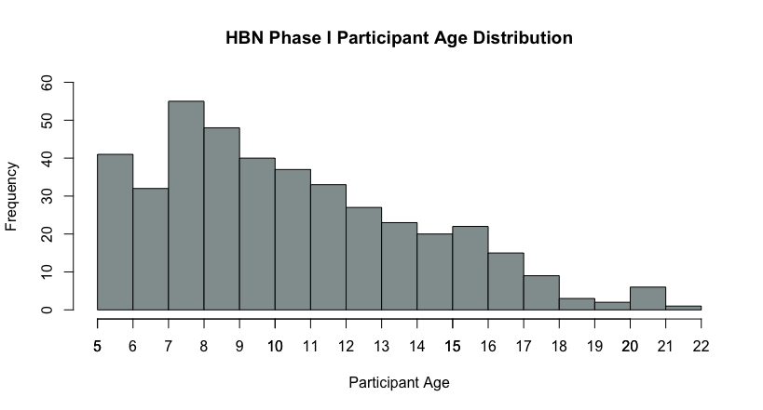
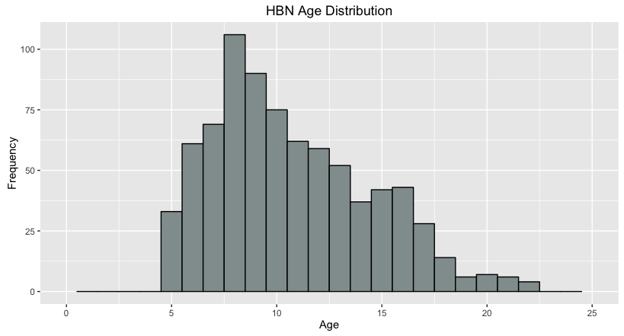


Built-in plot vs. ggplot

Slide 7
References & cheat sheets
R reference card | ftp://cran.r-project.org/pub/R/doc/contrib/Short-refcard.pdf
RStudio cheat sheets | https://www.rstudio.com/resources/cheatsheets/
ggplot | https://www.rstudio.com/wp-content/uploads/2015/03/ggplot2-cheatsheet.pdf
official R introduction | https://cran.r-project.org/doc/manuals/r-release/R-intro.pdf
official R definition | https://cran.r-project.org/doc/manuals/r-release/R-lang.pdf

